Slide 1



AI - Team 1:
Mohammad Zaatra
Amal AbuHmoud
Fatima Alzahra
TRAFFIC CONGESTION
AI PREDICTOR

Slide 2

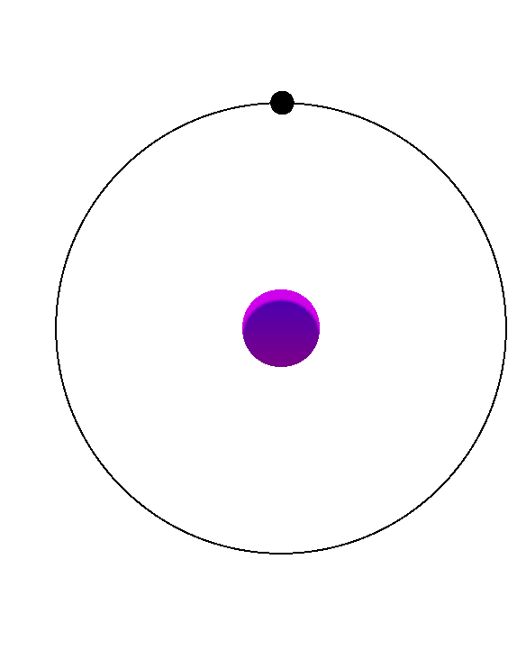
AI - Team 1
PROBLEM STATEMENT
Traffic congestion is a growing issue in urban areas, impacting daily commutes and productivity
.
Complex road networks and changing environmental conditions make it difficult to predict congestion accurately.

Slide 3
AI - Team 1
OUR SOLUTION
Key factors used for prediction:
Weather conditions
Road types
Vehicle types
Population density
Weather Impact Index
Accurate predictions can help:
Optimize traffic flow
Reduce delays
Improve overall urban mobility

Slide 4
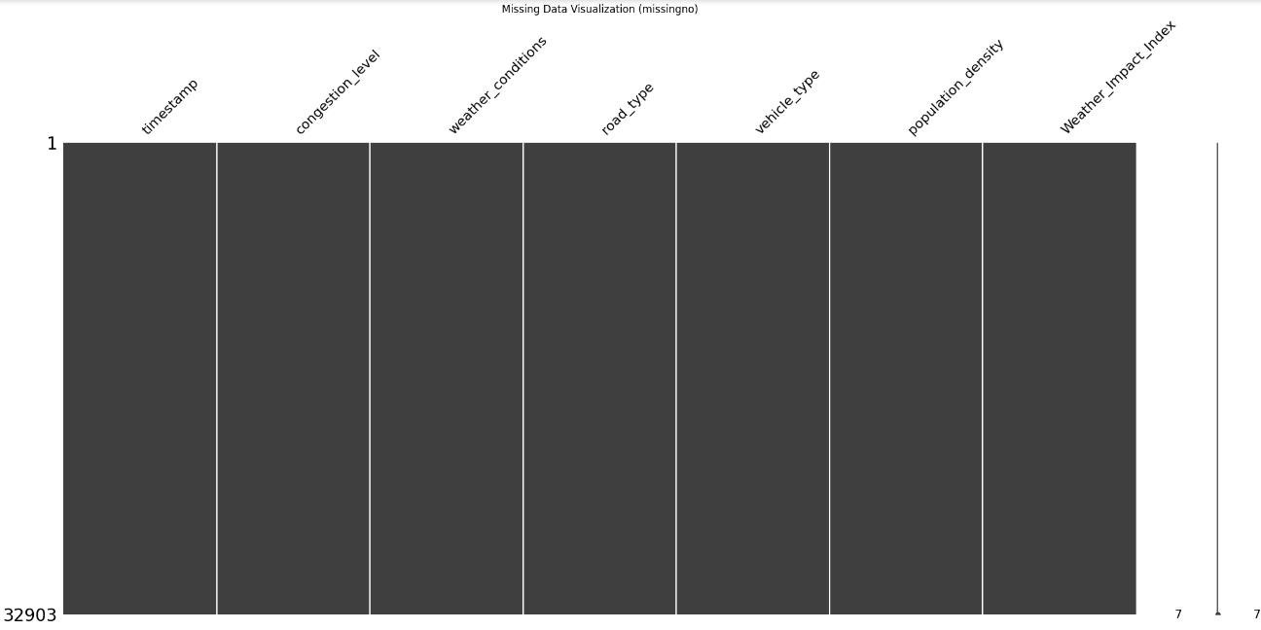
DATA EXPLORATION
AI -Team 1
MISSING DATA

Slide 5
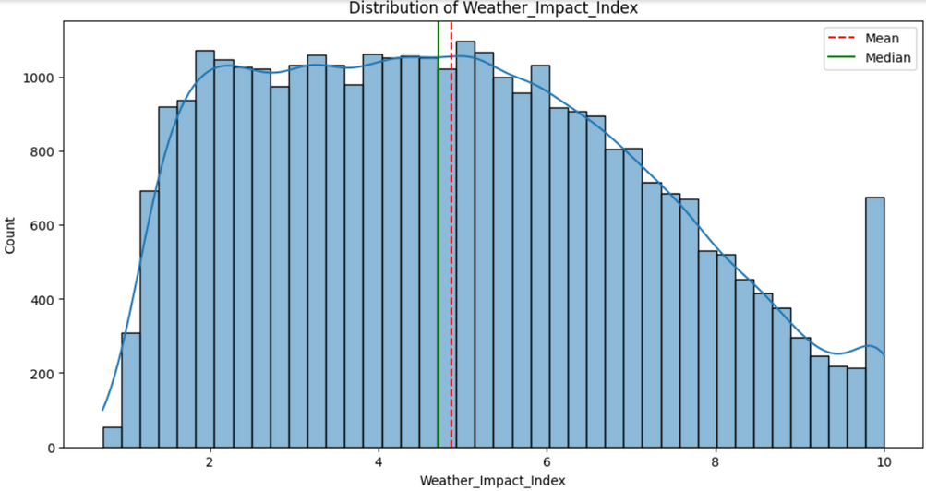
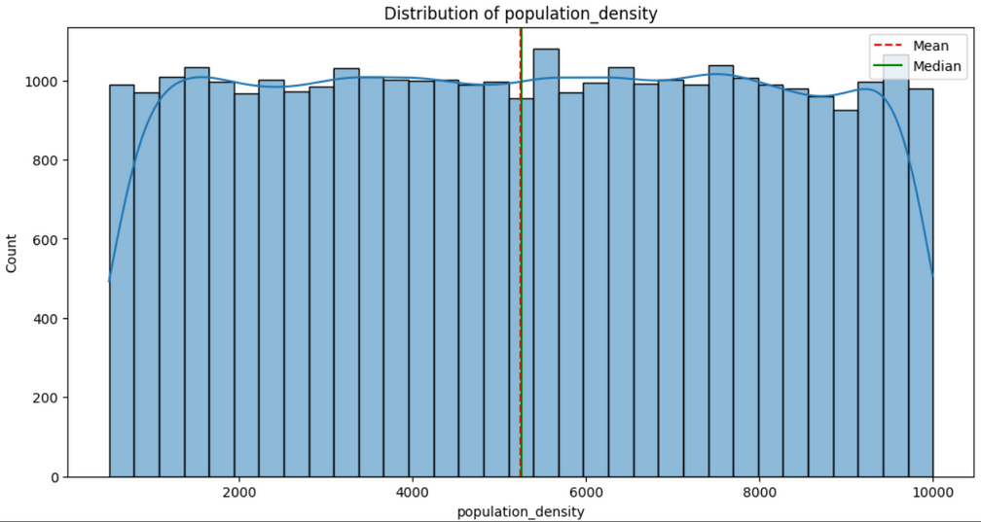
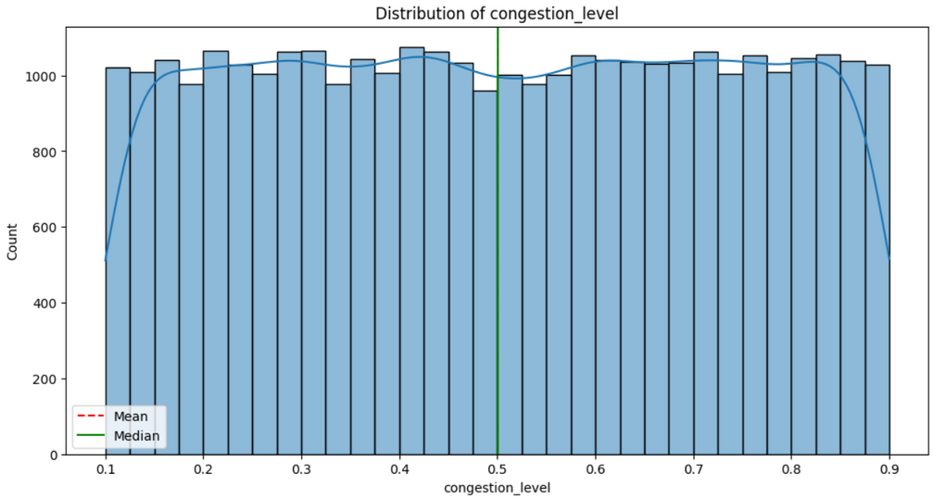
DATA EXPLORATION
AI -Team 1
DISTRIBUTION OF EACH FEATURE

Slide 6
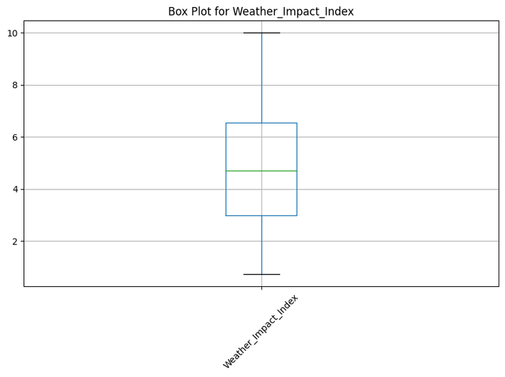
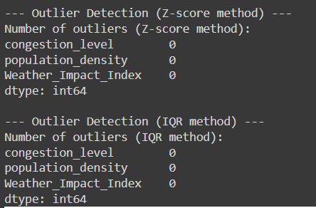
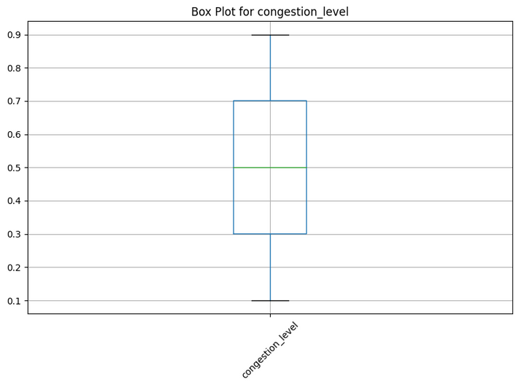
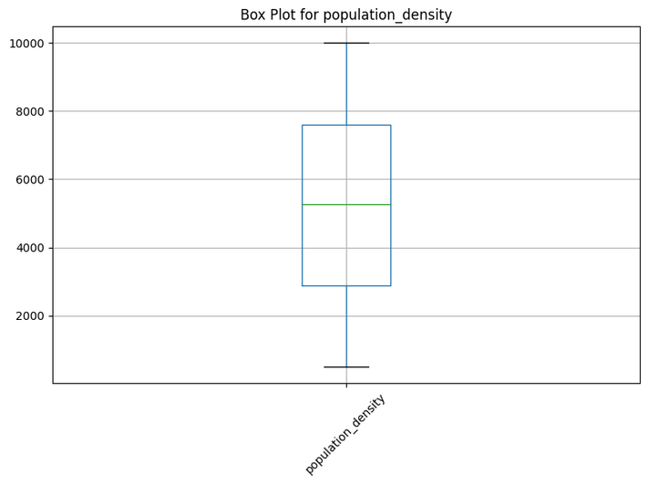
DATA EXPLORATION
AI -Team 1
OUTLIERS DETECTION

Slide 7
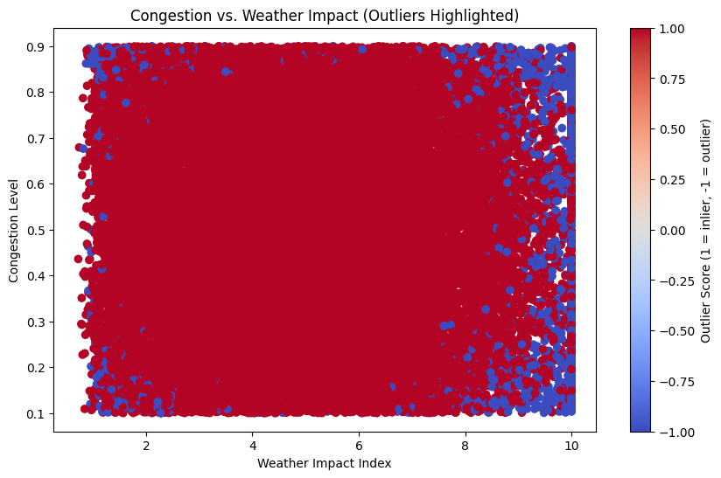
DATA EXPLORATION
AI -Team 1
OUTLIERS DETECTION USING ELLIPTIC ENVELOPE

Slide 8
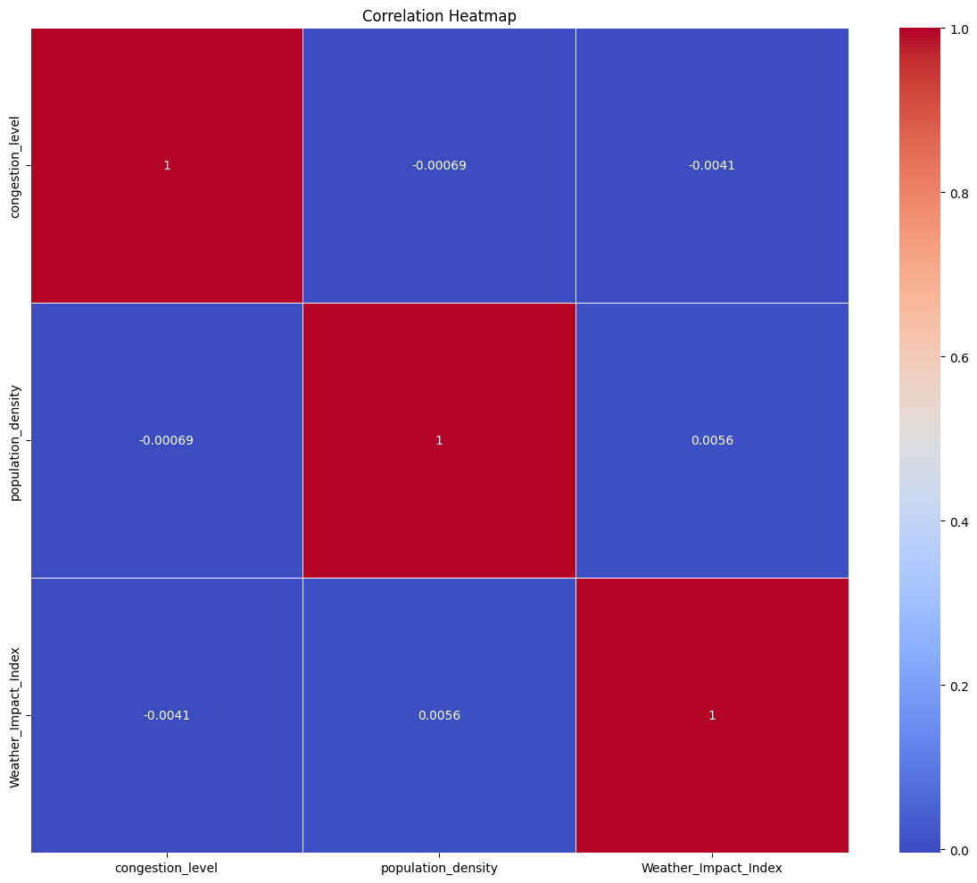
DATA EXPLORATION
AI -Team 1
CORRELATION ANALYSIS

Slide 9
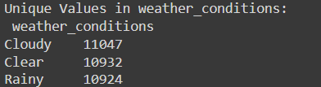
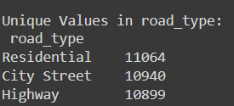
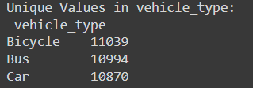
DATA EXPLORATION
AI -Team 1
UNIQUE VALUE COUNTS

Slide 10
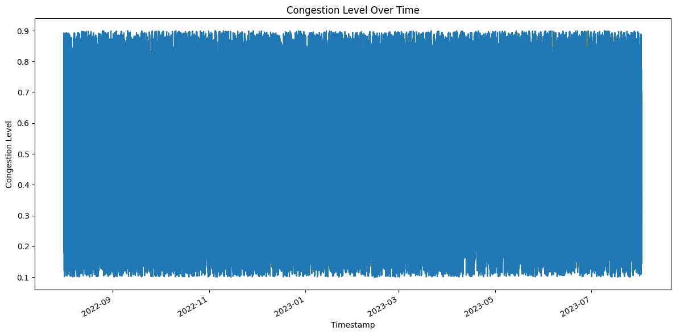
DATA EXPLORATION
AI -Team 1
TIME SERIES ANALYSIS

Slide 11
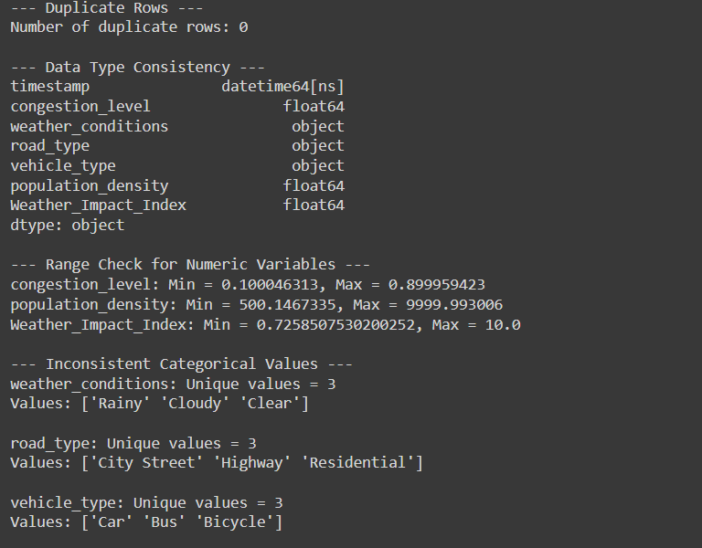
DATA EXPLORATION
AI -Team 1
DATA QUALITY CHECKS

Slide 12
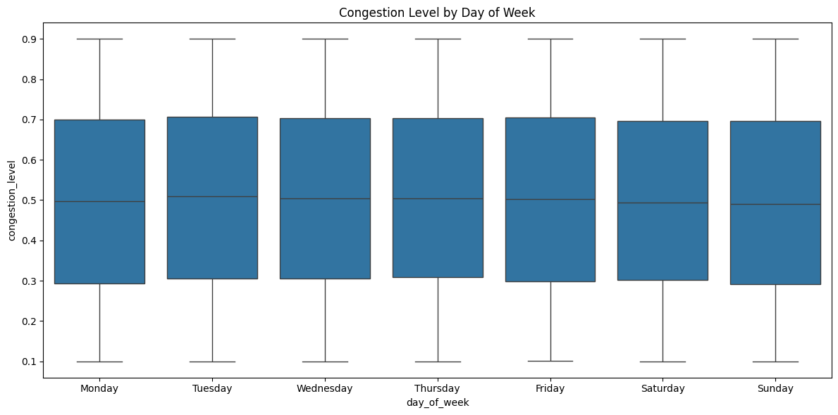
DATA EXPLORATION
AI -Team 1
DAY OF WEEK PATTERNS OF CONGESTION LEVEL

Slide 13
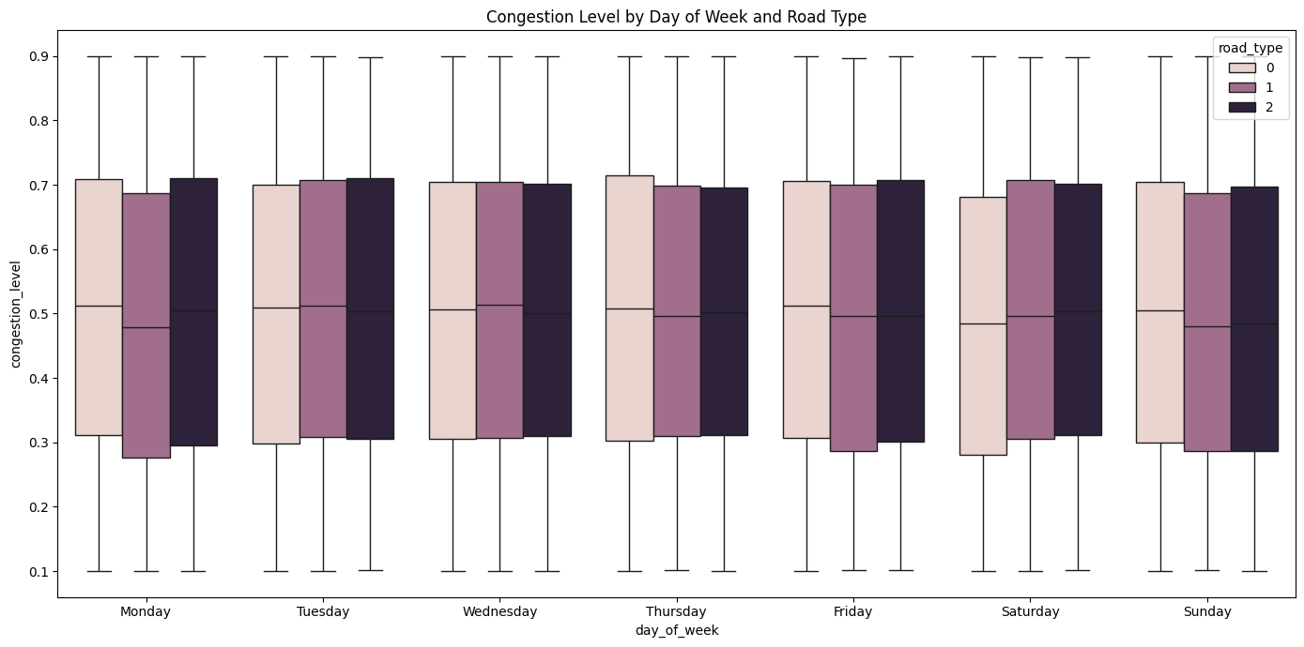
DATA EXPLORATION
AI -Team 1
DAY OF WEEK PATTERNS OF USED FEATURES

Slide 14
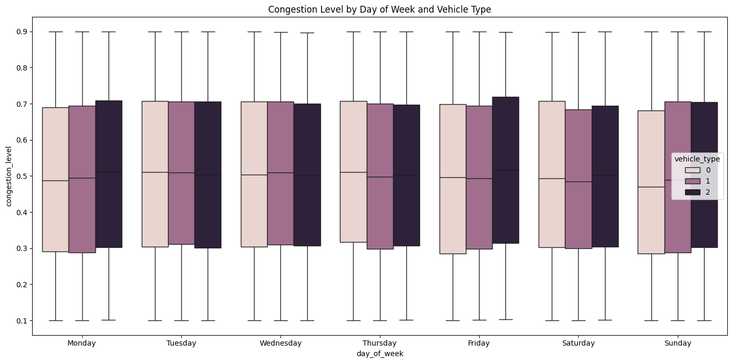
DATA EXPLORATION
AI -Team 1
DAY OF WEEK PATTERNS OF USED FEATURES

Slide 15
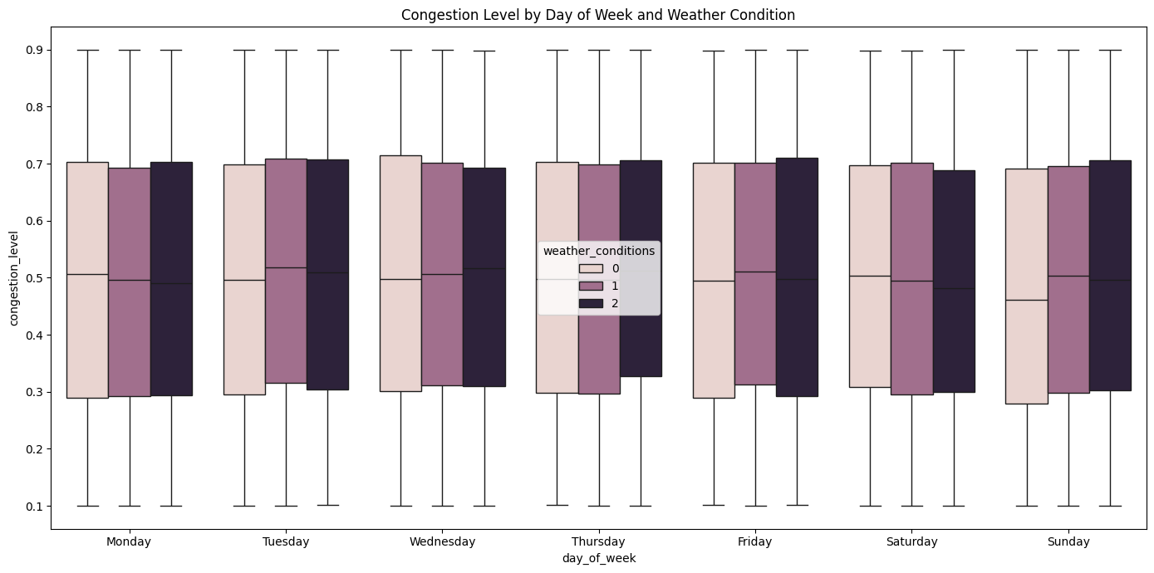
DATA EXPLORATION
AI -Team 1
DAY OF WEEK PATTERNS OF USED FEATURES

Slide 16
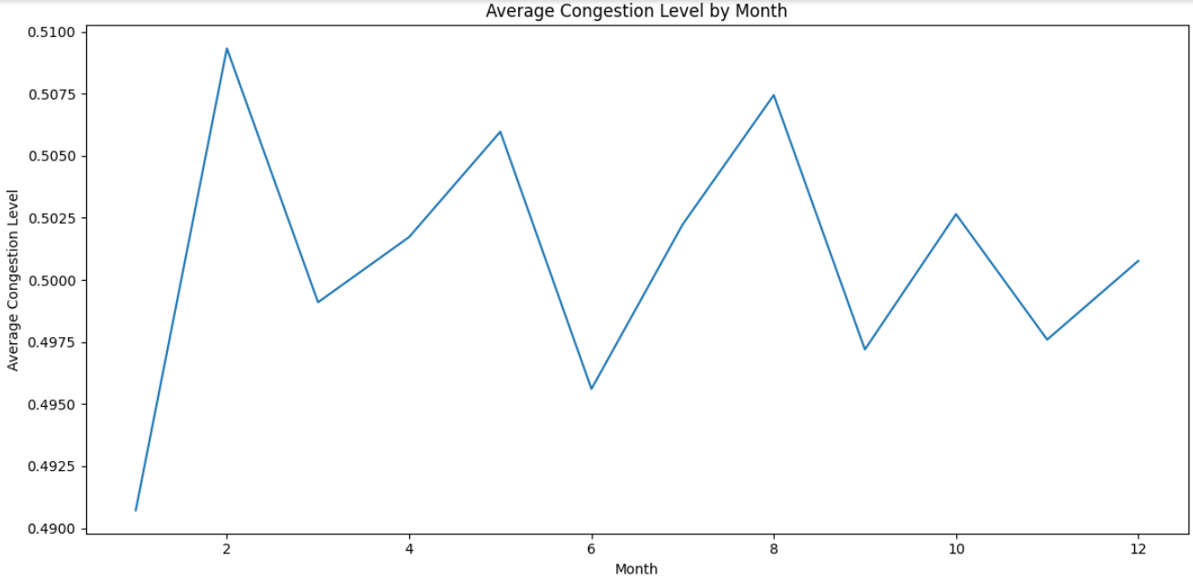
DATA EXPLORATION
AI -Team 1
SEASONAL PATTERN OF CONGESTION

Slide 17
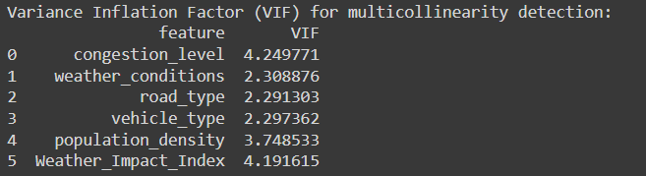
DATA EXPLORATION
AI -Team 1
CHECK FOR MULTICOLLINEARITY (USING VIF)

Slide 18
Key concepts:
Linear vs. Non-Linear Models:
Linear models (e.g., Linear, Ridge, Lasso)
Non-linear models (e.g., RandomForest, LSTM)
Regularization:
Ridge and Lasso apply penalties to control overfitting,
Ensemble Learning:
RandomForest uses multiple decision trees to combine predictions, reducing overfitting and improving accuracy.
Sequential Data & Time-Series Prediction:
LSTM handles time-dependent data, ideal for predicting changing traffic patterns over time.
Data Normalization & Scaling:
Normalization (MinMaxScaler): crucial for models like LSTM, which are sensitive to different data scales.
Ensures that features like congestion level and population density are on a similar scale.
AI -Team 1
KEY CONCEPTS
& MODEL SELECTION

Slide 19
AI -Team 1
Algorithms considered:
Linear Regression
Ridge & Lasso Regression
RandomForest Regressor
LSTM (Long Short-Term Memory)
Final model selection:
LSTM (Long Short-Term Memory)
KEY CONCEPTS
& MODEL SELECTION

Slide 20

AI -Team 1
DATA CLEANING
PROCESS
------------------

Slide 21

AI - Team 1
MODEL EVALUATION METRICS & RESULTS
-------------------

Slide 22
AI -Team 1
RECOMMENDATIONS
-----------------

Slide 23
AI -Team 1
THANK YOU!
QUESTIONS TIME

